Slide 1
Data Visualization of Bird Strick Between 2000 - 2011
By Vaishnavi Madhukar Samal

Slide 2
Introduction
A bird strike is strictly defined as a collision between a bird and an aircraft which is in flight or on a take-off or landing roll. The term is often expanded to cover other wildlife strikes - with bats or ground animals. Bird Strike is common and can be a significant threat to aircraft safety.
Bird strikes may occur during any phase of flight, but are most likely during the take-off, initial climb, approach and landing phases due to the greater numbers of birds in flight at lower levels.

Slide 3
Main KPI’s
Average Cost due to Bird Strick
Total Bird Strickes
Average Altitude of Aircraft in different phases

Slide 4
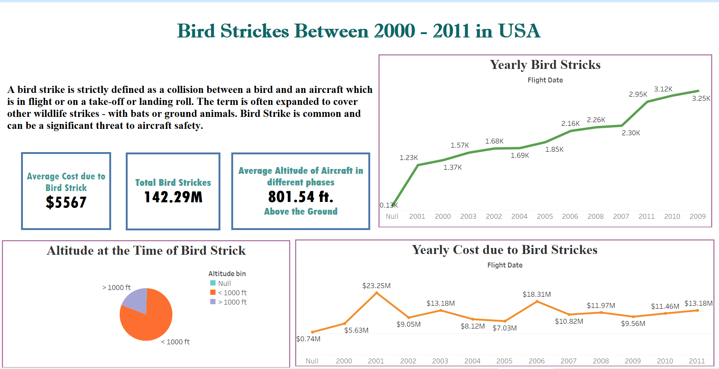
My Dashboards
Dashboard 1 :

Slide 5
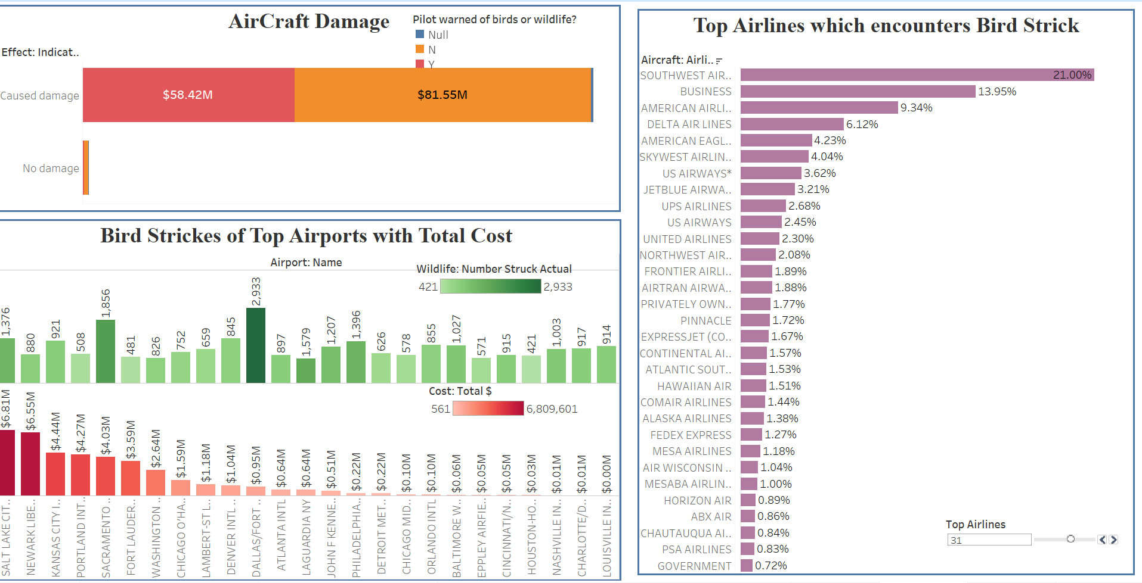
Dashboard 2 :

Slide 6
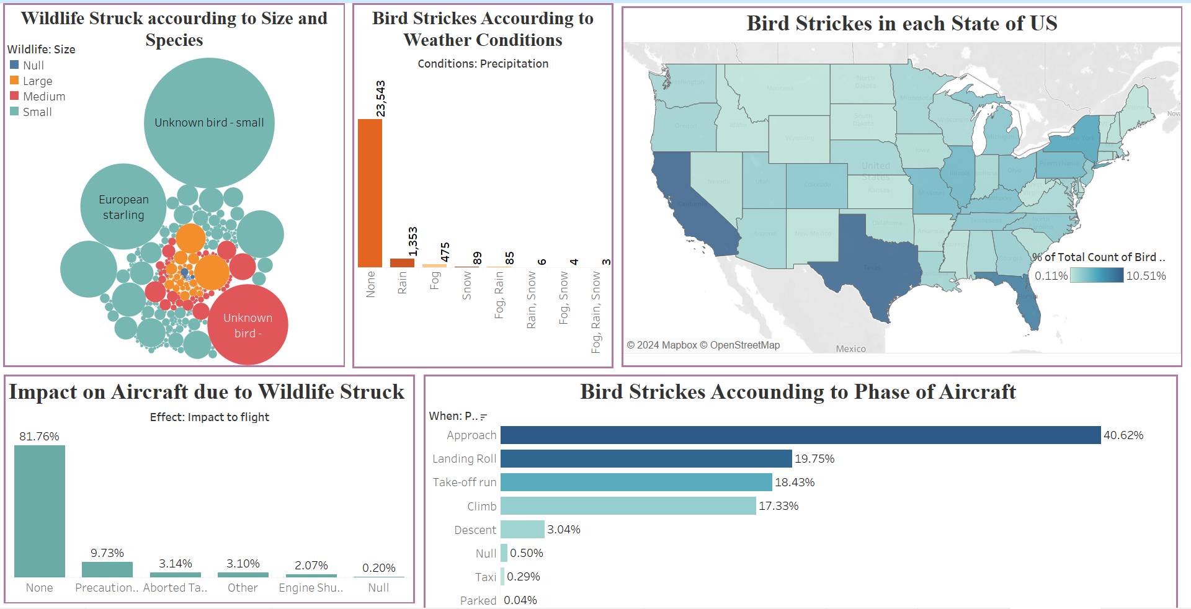
Dashboard 3:

Slide 7
Thank You

